Slide 1
Creativity offers us a new formula for life
Join the Augmented Society Network to lift the lid on some of this century’s most important societal and technological challenges
ASN Project 2022-23
The ASN an RSA Fellow Network

Slide 2
Creativity offers us a new formula for life
ASN Project 2022-23
The ASN an RSA Fellow Network

Slide 3
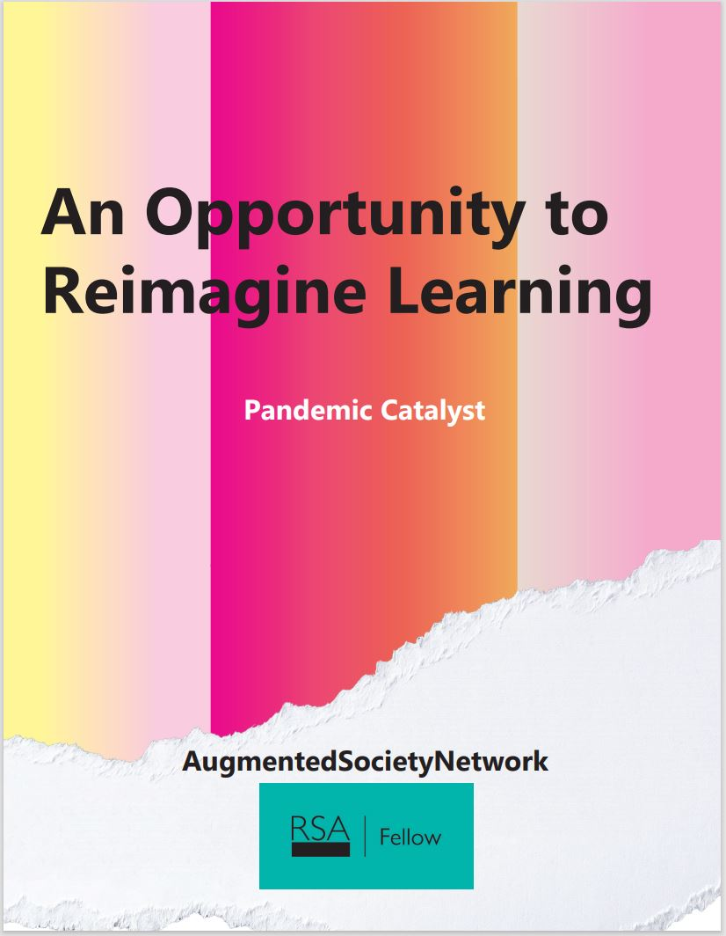
Creativity offers us a new formula for life
ASN 2021 Project An opportunity to re-imagine learning
30 Authors 5 continents
ASN Project 2022-23
The ASN an RSA Fellow Network

Slide 4
Creativity offers us a new formula for life
ASN 2022/23 Project Creativity offers us a new formula for life
ASN Project 2022-23
The ASN an RSA Fellow Network

Slide 5
Creativity offers us a new formula for life
Explore how creativity drives innovation, science and manufacturing; how it could provide solutions to world problems; and help us to adapt to change
ASN Project 2022-23
The ASN an RSA Fellow Network

Slide 6
Creativity offers us a new formula for life
The project:
provides the opportunity to rethink the importance of creativity by eliciting on our individual creative experiences & through learning from others
will bring the diverse expression of creativity together in one simultaneous online event & exhibition
ASN Project 2022-23
The ASN an RSA Fellow Network

Slide 7
Creativity offers us a new formula for life
The project:
project leads on 5 continents, the global RSA & other contacts to gather 99+ creative experiences globally
is a unique opportunity to harness collaboration across all lived experiences around the world
ASN Project 2022-23
The ASN an RSA Fellow Network

Slide 8
Creativity offers us a new formula for life
Your commitment:
demonstrate, document & showcase creative experience
explore what the future holds for humankind - using creativity to redesign our impact on the environment and society
ASN Project 2022-23
The ASN an RSA Fellow Network

Slide 9
Creativity offers us a new formula for life
Current Project team:
Zoe Camper FRSA, Founder & CEO of Zoë Camper LLC. Co-founder The Augmented Society Network (North America)
Julie Samuels FRSA (M Phil), researcher, author & artist working in social enterprise on arts & heritage projects (UK and Europe) Carlos Largacha-Martinez, TEDx speaker, social inventor/futurologist, Fulbright Fellow Post-Doc Scholar Program (South America)
Mitch Weisburgh, co-founder Academic Business Advisors, developing business strategies to align products/services with purchasing decisions & technology for schools (North America) Rachida Merbough (DrBA), certified renewable energies finance, Frankfurt School of Finance and Management (Africa) Lynda Leavitt EDD, Professor, College of Education and Human services Lindenwood University, Missouri (North America)
ASN Project 2022-23
The ASN an RSA Fellow Network

Slide 10
Creativity offers us a new formula for life
Discussion:
What do we want to achieve?
What do you want to contribute?
ASN Project 2022-23
The ASN an RSA Fellow Network

